Slide 1
MN Public Employees Insurance Program (PEIP)
Group Online Premium Payment
We encourage all payors to use the online payment system. We hope you find these instructions helpful in setting up your payments.
If you have any problems with the process, please call us at 952-746-3106.

Slide 2
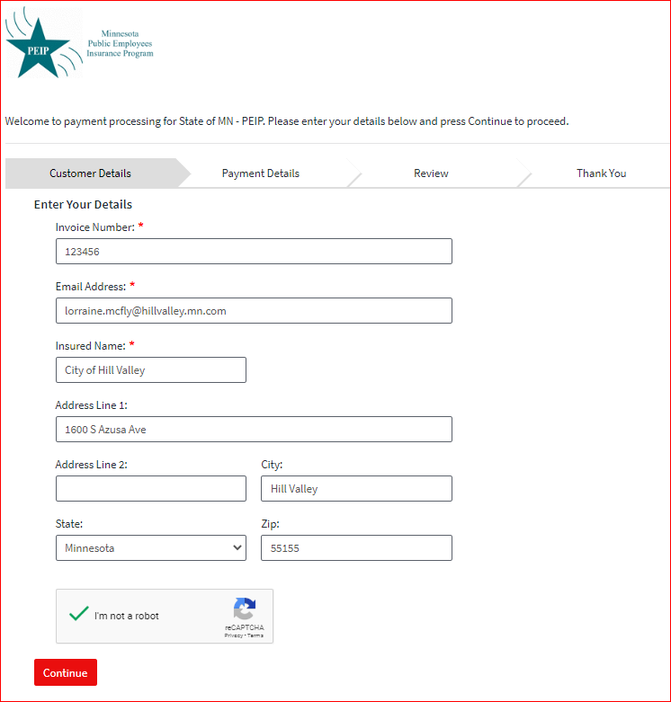
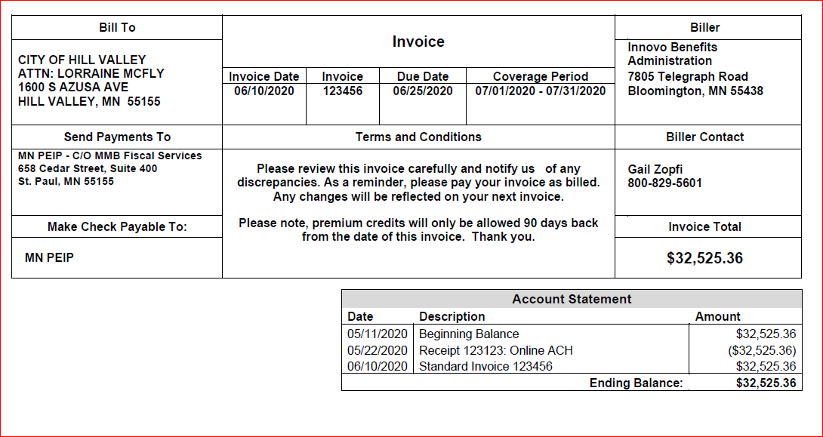

Slide 3
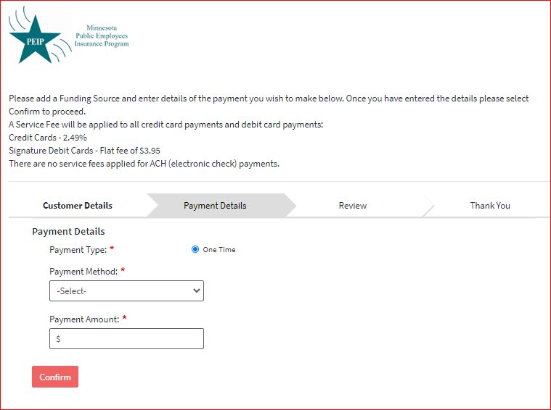
Use the drop-down to select either ‘New Bank Account’ (for an ACH payment), or ‘New Card Account’ (for a credit card or debit card payment)

Slide 4
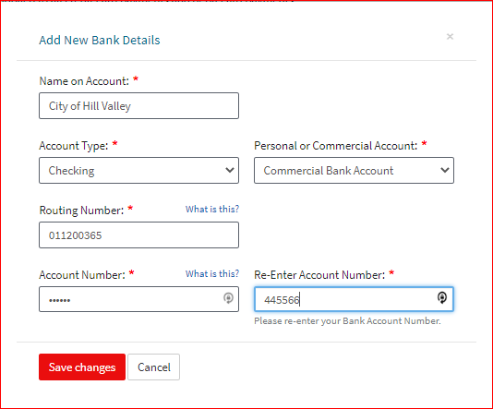
After selecting your payment type, please enter your account information.

Slide 5
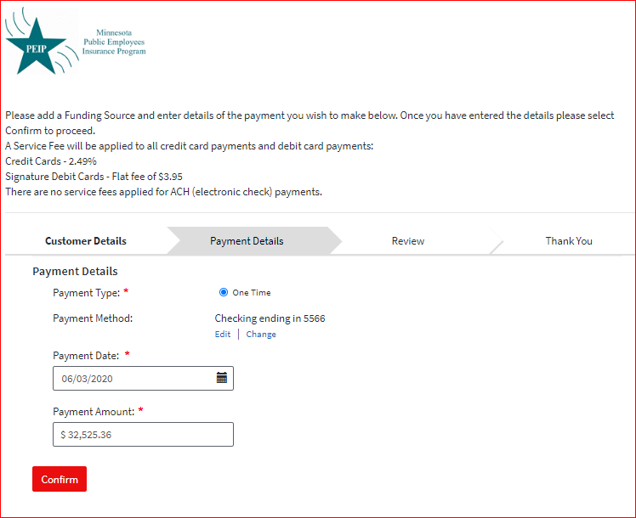
Enter the date on which you want the payment made and the amount you want to pay.

Slide 6
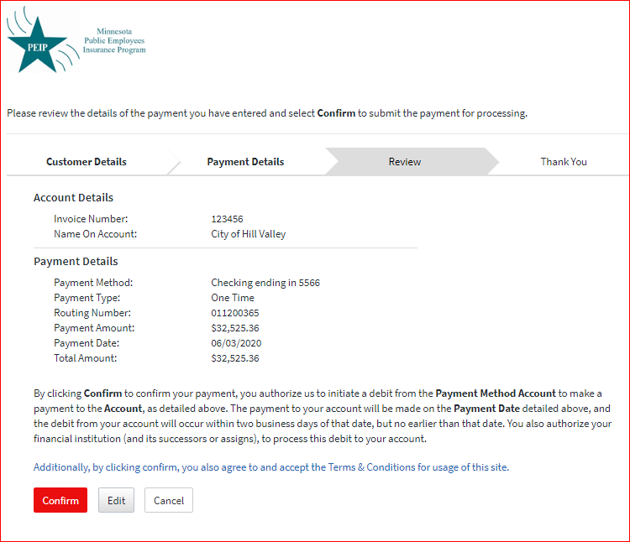
Review payment details, then click ‘Confirm’ to make the payment, ‘Edit’ to make any changes, or ‘Cancel’

Slide 7
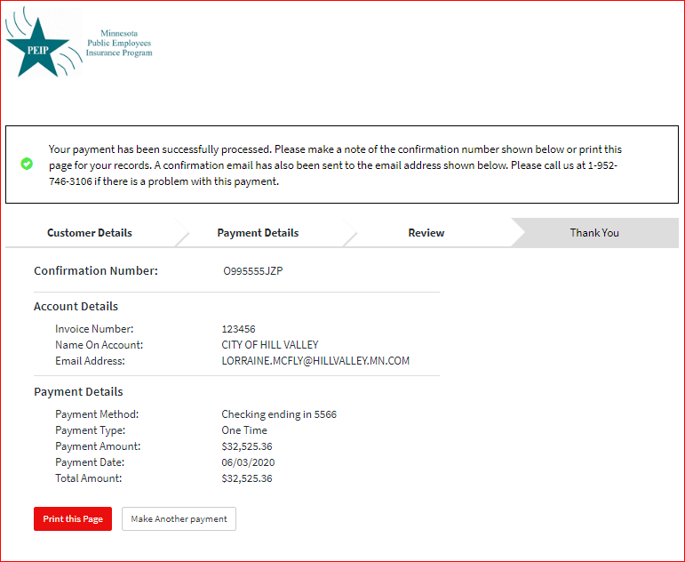
The last page shows the details of the payment. You may print or save the page. An email with the payment details will be sent to the email address entered on the first screen.

